Slide 1
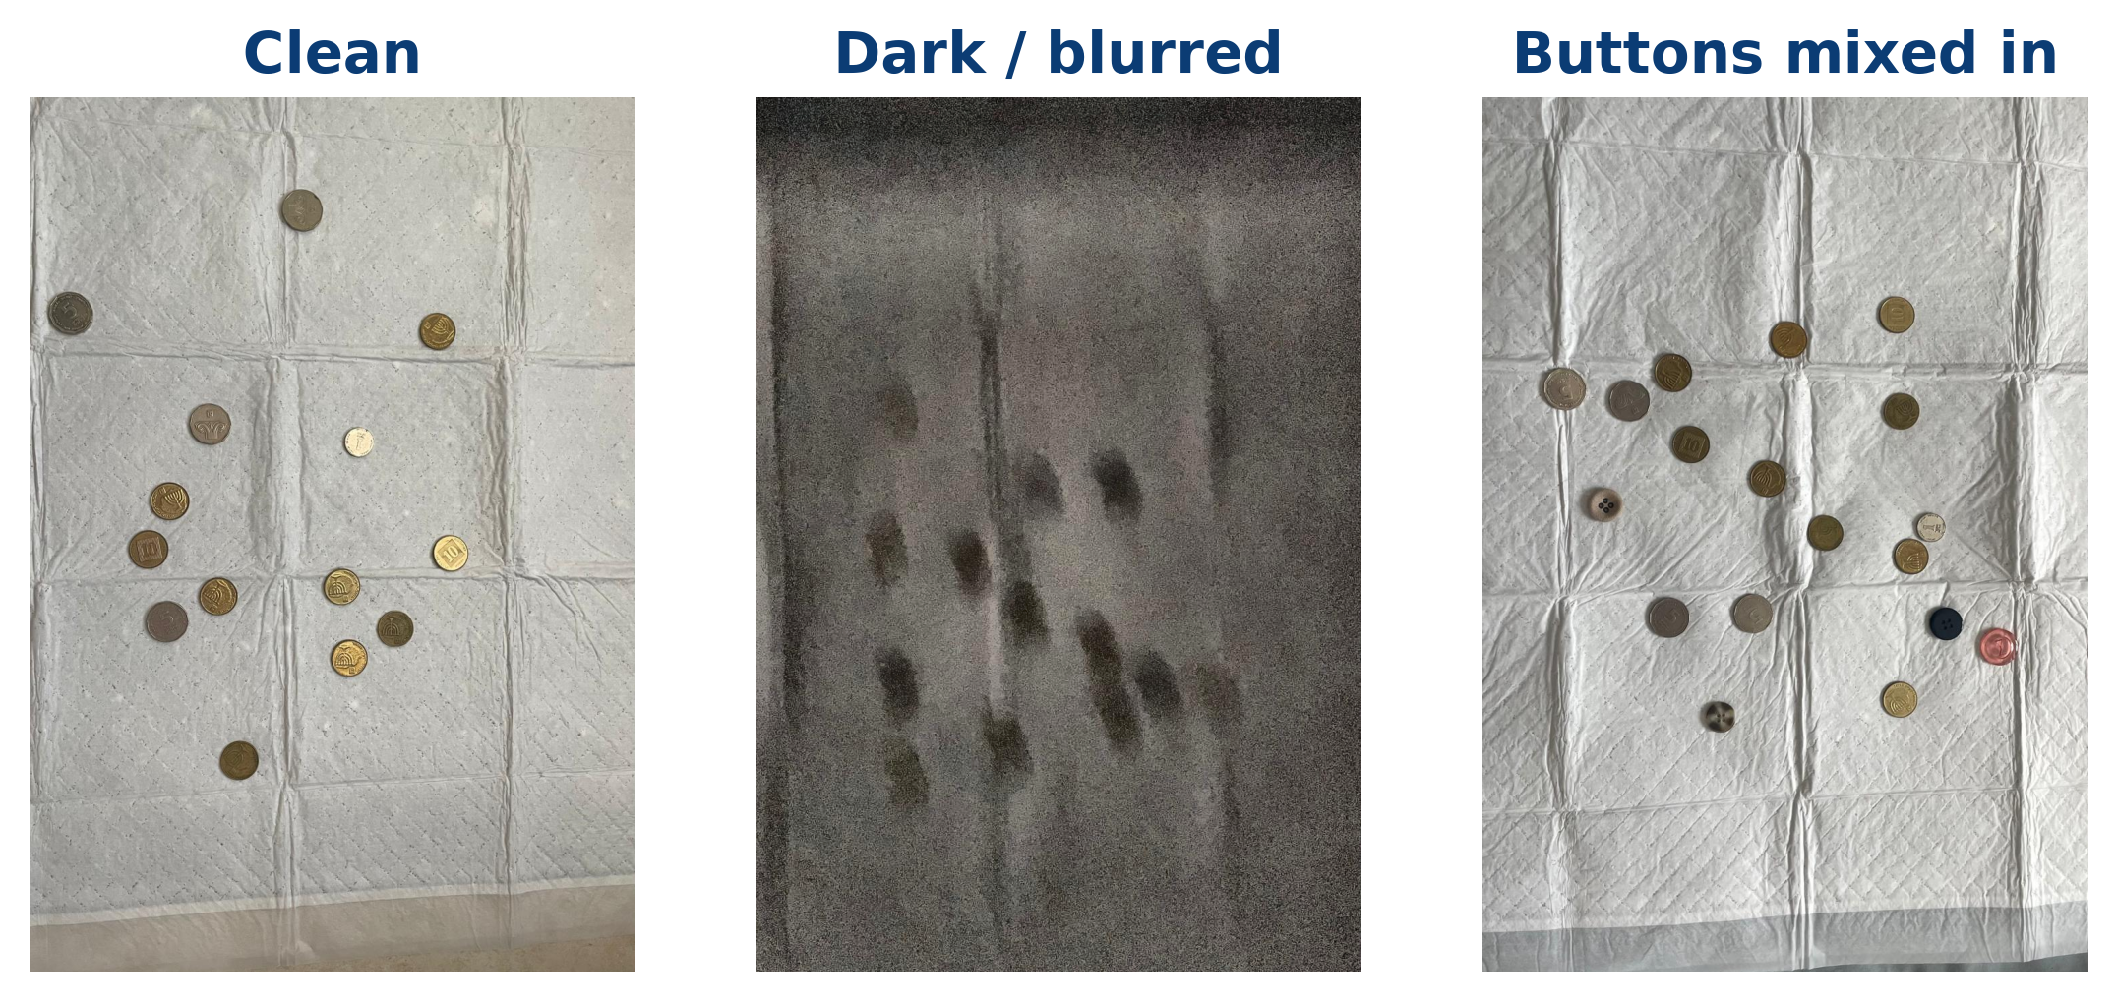
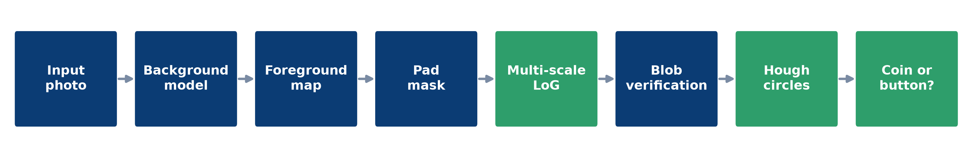
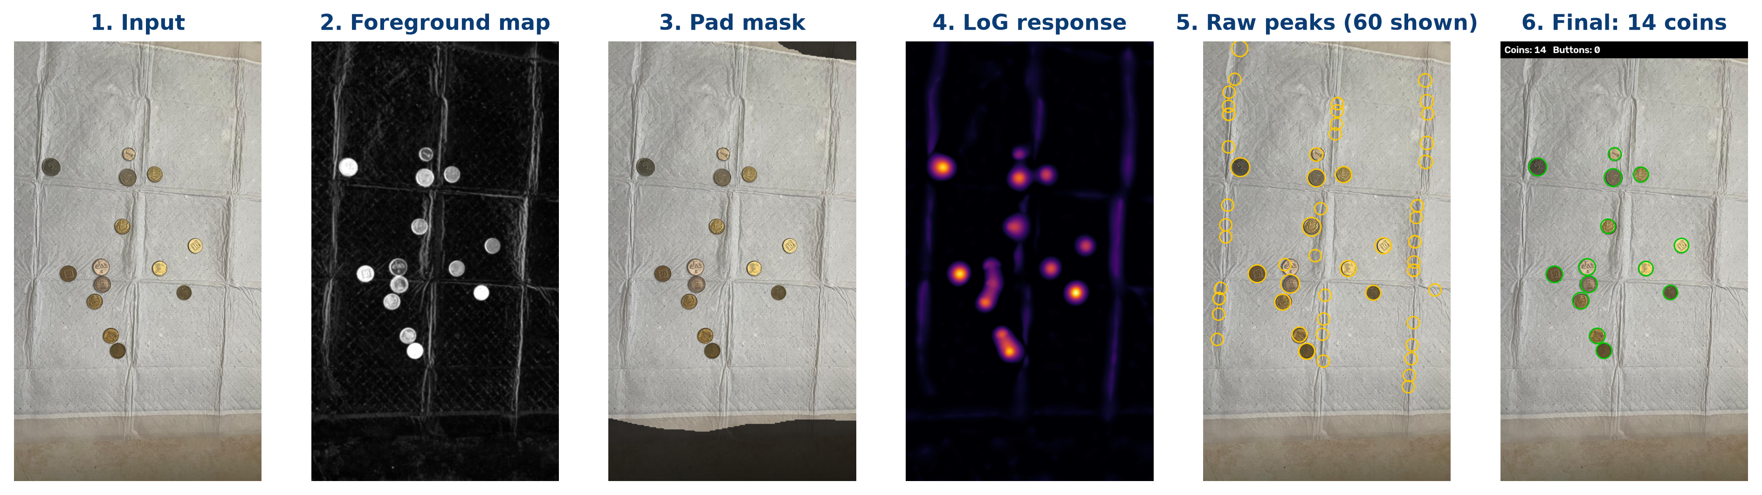
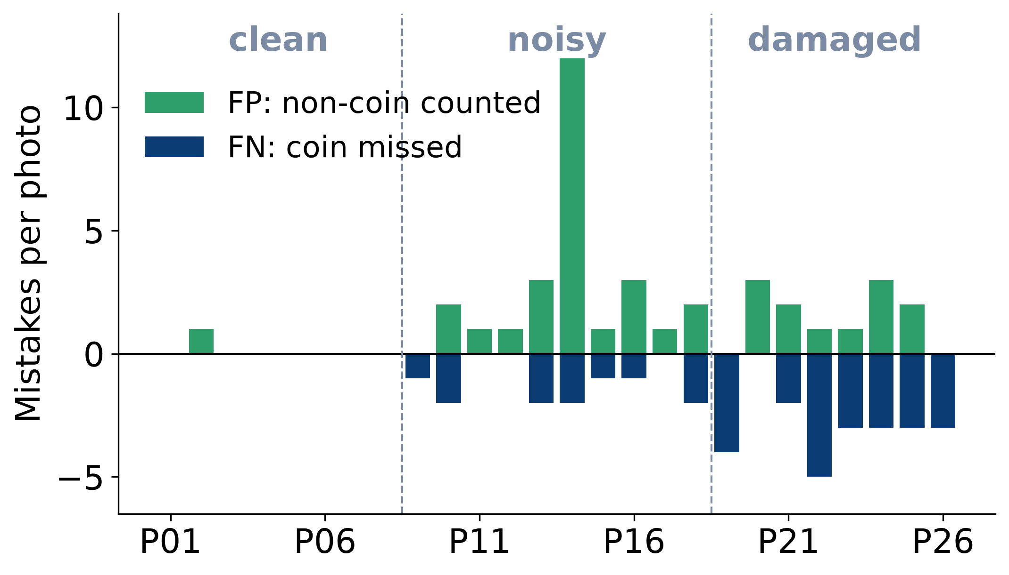
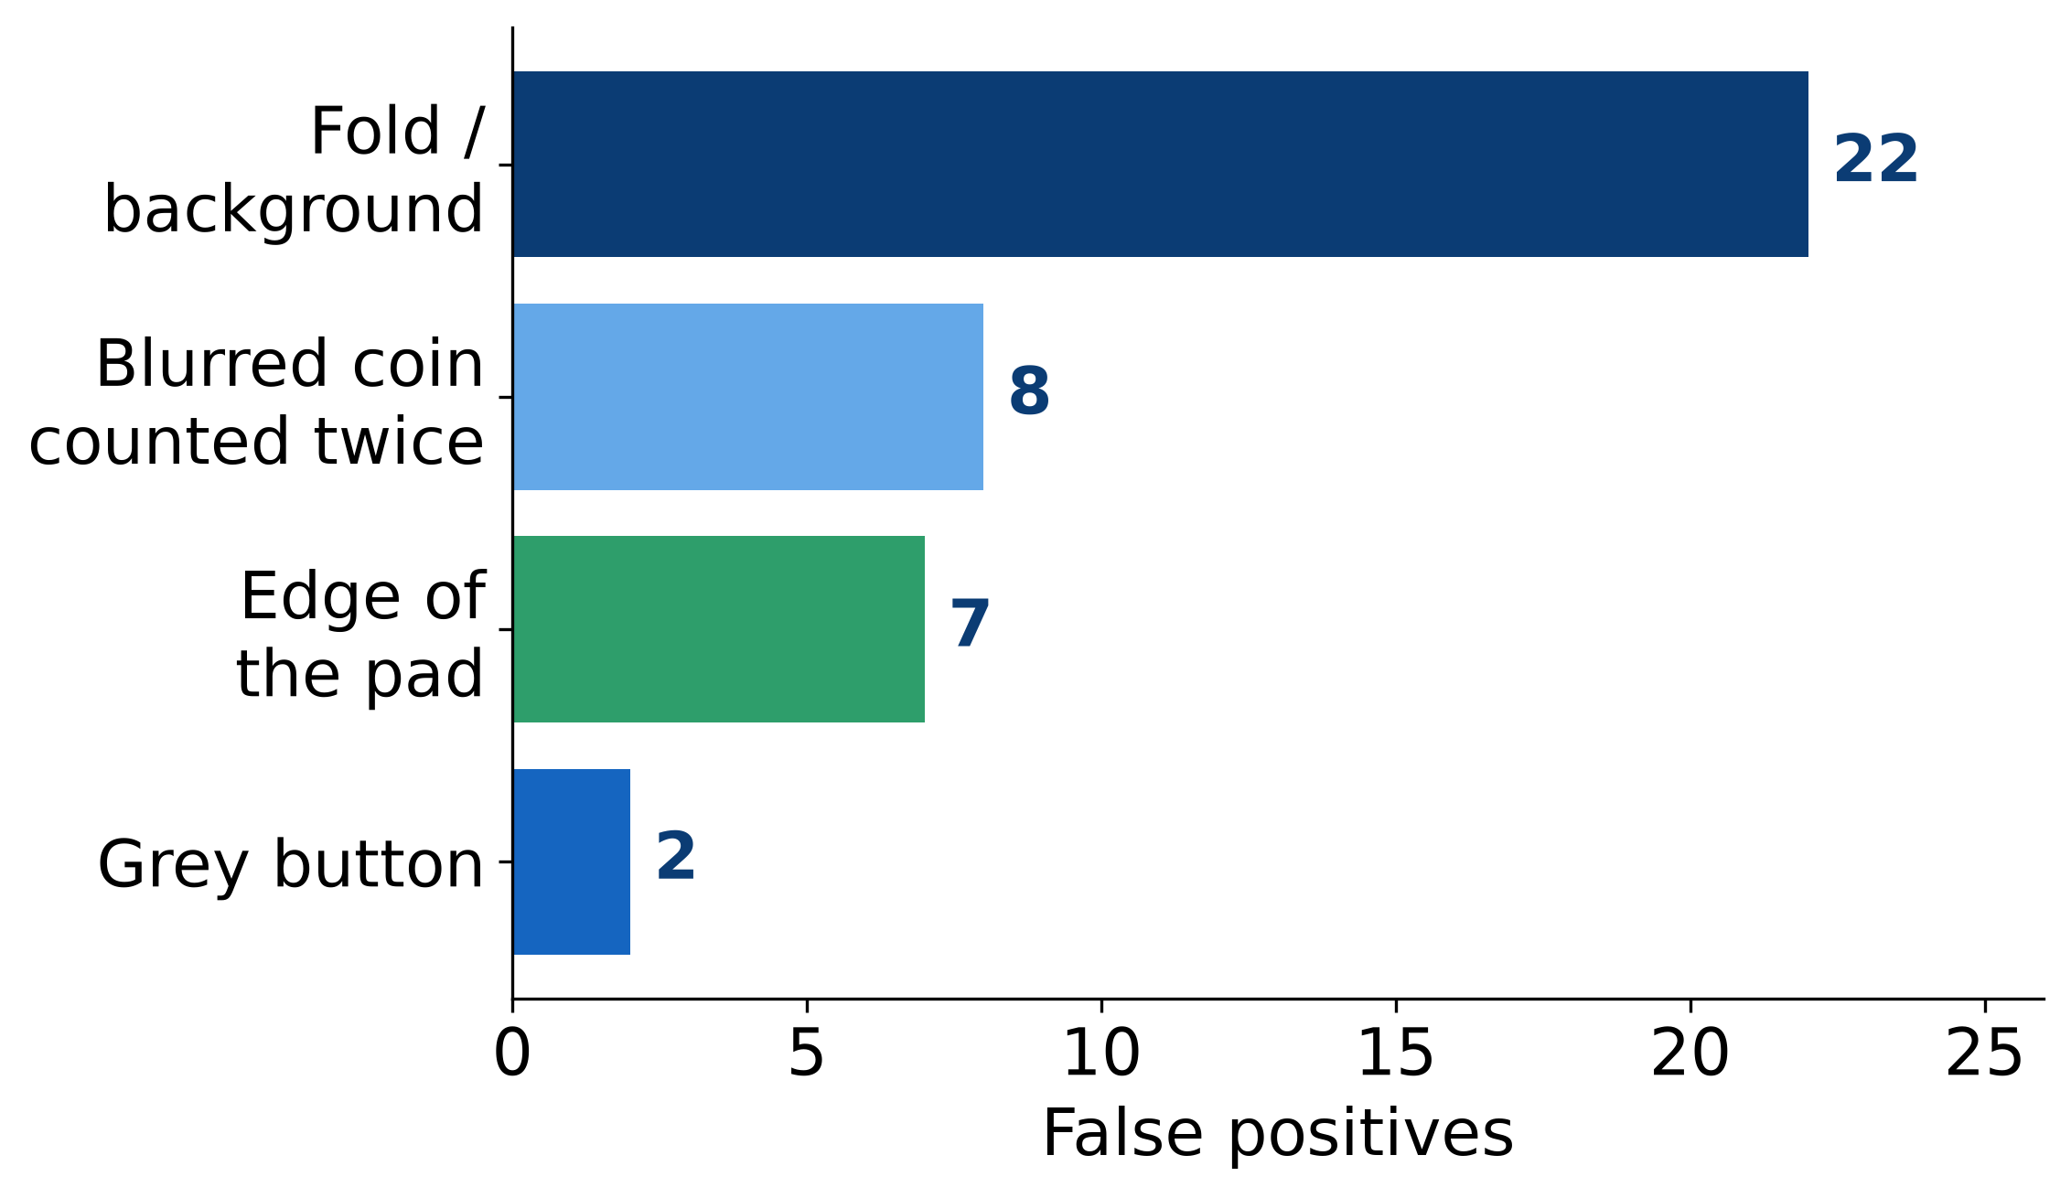

Every Coin Counts
Counting coins on a textured pad with classical image processing
Lecturer
Yulia Rapana
Dr. Cornel Lustig
Image Processing · Holon Institute of Technology (HIT)
Summer semester 2026
01 Introduction
People count coins at a glance; a computer sees only pixels. These phone photos add three traps: a white pad full of folds, dark or motion-blurred shots, and round buttons the size of a coin.
Goal count only the coins with fixed classical rules, with no training and no machine learning.
Question can such rules cope with these conditions, and which objects does the program get wrong?
02 Method
Background: a very large median filter models the pad and light; each pixel gets a Lab difference score.
Blobs: multi-scale Laplacian of Gaussian finds round, coin-sized peaks.
Folds: a Hessian shape test rejects ridges; grayscale opening removes seams.
Touching coins: Hough circles separate what LoG merges.
Not a coin: black-hat finds sewing holes; blue or pink is rejected.
Evaluation: 26 photos, 328 hand-counted coins; every circle checked as TP, FP or FN.
Photo → foreground map → pad mask → LoG → raw peaks (mostly folds) → 14 coins
03 Results
89.6%
88.3%
39 / 34
12/26
recall
precision
false / missed
exact counts
294 of 328 coins found
294 of 333 detections
FP non-coins · FN coins
only 7 with no mistake
False detections (up) and missed coins (down) per photo
What was mistaken for a coin (39 FP)
04 Conclusions
05 Discussions
Target: count only the coins under changing conditions.
Achieved: 89.6% recall, 88.3% precision with classical rules only; all 98 coins found on clean photos and 9 of 12 buttons rejected. Dark photos add false coins; piles hide real ones.
Next: merge detections along the blur direction, drop the pad's white hem from the mask, fit partial circles at the frame, and use rim colour for grey buttons.
Source code

